Slide 1


REF2021: The Results
Jodi Lindsay
Academic Lead for REF2021
June 16th 2022
The slides and presentation will be deposited on the SGUL website
https://www.sgul.ac.uk/research/our-impact/research-excellence-framework/ref-2021

Slide 2
Overview
What is REF2021?
Our submission and how it was assessed
How our staff were chosen for submission
Outputs /papers
Impact cases
Environment statements
Rankings, reputation and income
Future REFs
SGUL’s REF2021 submission (and a lot more!) is available on the website
https://www.sgul.ac.uk/research/our-impact/research-excellence-framework/ref-2021
REF2021 is important to St George’s for reputation and income
Every university’s REF2021 submission will be publicly available on the REF2021 website in the next few weeks.
Includes academic names, papers and impact cases, but specific scores of individual papers and cases are not.

Slide 3
Research Excellence Framework (REF)
http://www.ref.ac.uk/
REF is the system for assessing the quality of research in UK universities and higher education colleges.
The key purposes of the REF are:
to inform the selective allocation of funding for research
to provide accountability for public investment in research and produce evidence of the benefits of this investment
to provide benchmarking information and establish reputational yardsticks, for use in the higher education sector and for public information.
Managed by Research England.
REF (or RAE) is held every 6-7 years, and the outcome determines funding until the next exercise
The budget for distribution is currently approx. £2 billion, this money is designed to underpin research.

Slide 4
The assessment period for REF2021 was Jan 2014 – Dec 2020.
We were assessed on :
- Outputs (publications) (60%)
- Impact cases (25%)
- Environment (15%)
Each Output, Impact case or Environment submission was assessed as either
4* - world leading
3* - internationally excellent
2* - internationally recognized
1* - nationally recognized
Unclassified - ineligible
Assessments were subject specific. There were 34 Units of Assessment, and each UoA sub-panel consisted of dozens of academic experts who agreed the scoring.
SGUL submitted to two UoAs -
- Clinical Medicine (UoA1)
- Public Health, Health Services and Primary Care (UoA2)
The full guidance and results are at www.ref.ac.uk

Slide 5
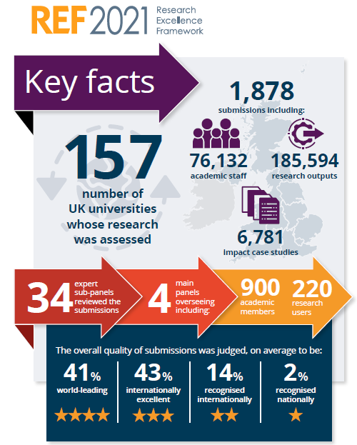

Slide 6

Which staff are eligible for REF submission?
100% of SGUL’s eligible staff were submitted.
Eligibility was based on our Code of Practice which was widely consulted with our staff, and approved by REF2021
https://www.sgul.ac.uk/research/our-impact/research-excellence-framework/ref-2021
Eligible staff were those who on the census date of 31 July 2020
Had a Significant responsibility for research
(at SGUL : are a Member or Joint Member of a Research Institute)
Were ‘independent’
(at SGUL: job title is Lecturer, SL, Reader, Prof or holder of an independent fellowship post-PhD)
Employed by SGUL at least 0.2 full time equivalents (FTEs)

Slide 7

SGUL submitted :
UoA1 (Clinical Medicine) – 93.4 FTE (100 staff)
UoA2 (Public Health) – 14.67 FTE (19 staff)
SGUL nearly doubled the number of submitted staff (94% increase) compared to last REF2014, showing an increase in our academic strength.
This compares to the REF2021 overall which saw a 46% increase in submitted staff from all universities.

Slide 8

Outputs
Numbers of outputs - Rules
All REF2021 eligible academics must submit at least one output (paper)
The maximum number of papers submitted by one academic is five.
The total number of papers submitted must be 2.5 x FTE
SGUL submitted :
UoA1 (Clinical Medicine) – 234 papers
UoA2 (Public Health) – 37 papers

Slide 9
Outputs - REF2021 specific guidance
The REF2021 sub-panels looked for evidence of the quality of the output in terms of its originality, significance and rigour
Originality – the extent to which the output makes an important and innovative contribution to understanding and knowledge in the field
Significance – the extent to which the work has influenced or has the capacity to influence, knowledge and scholarly thought, or the development and understanding of policy and/or practice
Rigour – the extent to which the work demonstrates intellectual coherence and integrity, and adopts robust and appropriate concepts, analyses, sources, theories and/or methodologies
The use of Journal impact factors was heavily discouraged.
Instead, assessment panels were supplied with citation scores for each paper, in context by year of publication and subject area –
https://www.ref.ac.uk/guidance/citation-and-contextual-data-guidance/

Slide 10
What is an eligible paper?
1. First made publicly available between Jan 1, 2014 and Dec 31, 2020
2. Open access.
Before 1 April 2016 not required.
1 April 2016 – 31 March 2018, deposited in CRIS/SORA within 3 months of publication
After 1 April 2018, deposited in CRIS/SORA within 3 months of acceptance
3. Contribution
Nominated academic is one of FIFTEEN or less authors
OR
Nominated academic is a lead or corresponding author
OR
Statement submitted with REF return on the nominated academic’s role, and ideally also published in the ‘Author Contribution’ section of the manuscript which takes precendent over any REF statement, which needs to include both :
  The author made a substantial contribution either to the conception and design of the study; or to the organization of the conduct of the study; or to carrying out the study (including acquisition of study data); or to analysis and interpretation of study data. AND
  The author helped draft the output; or critique the output for important intellectual content
.
NOTE – we expect the OA and authorship rules to change for the next REF

Slide 11
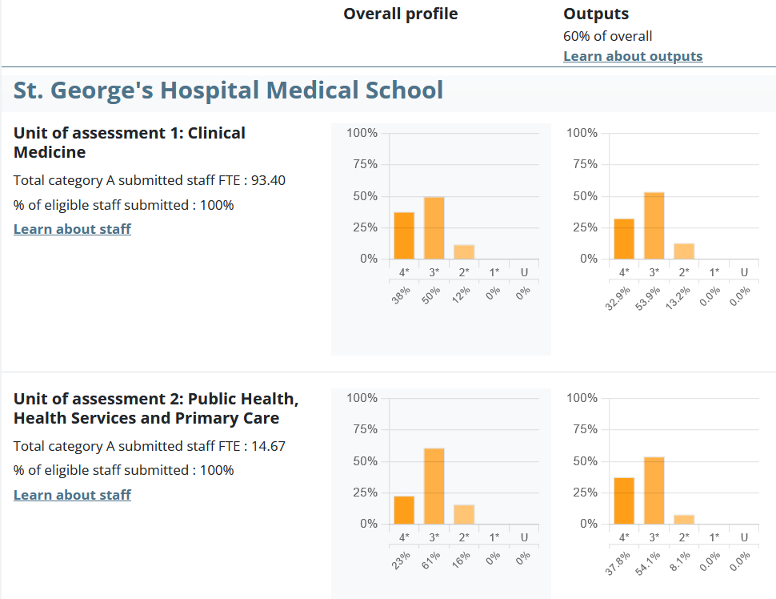
Results - Outputs
https://results2021.ref.ac.uk/profiles/institutions/10007782
Output rank : =34 of 129
=77
4* papers
=14
4* papers
In REF2014
Total of 47 4* papers

Slide 12

Impact Cases
St George’s submitted 9 impact cases, 7 for UoA1 and 2 for UoA2.
Underpinning research must have been published between Jan 2000 and Dec 2020.
Impact occurred between 1 Aug 2013 and 31 July 2020, supported by evidence.
Impact Cases Assessment –
Reach – the extent and/or diversity of the beneficiaries of the impact
Significance - the degree to which the impact has enabled, enriched, influenced
informed or changed the performance, policies, practices, products, services,
understanding, awareness or wellbeing of the beneficiaries.

Slide 13



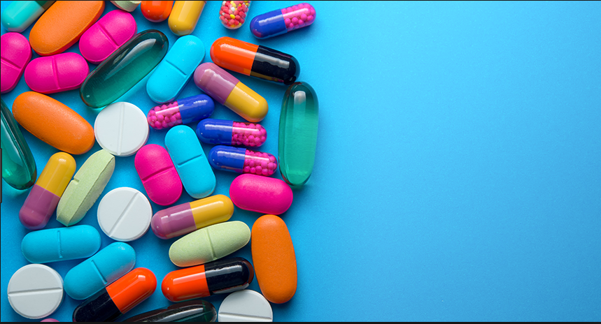
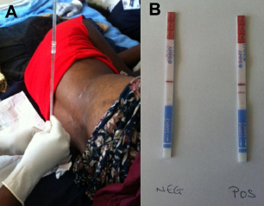
SGUL REF2021 impact cases were -
Driving strategies to prevent neonatal Group B streptococcal infection (Heath, Le Doare, Ladhani, Jones)
International recommendations for ECG interpretation in young athletes to identify those at risk of exercise related sudden cardiac death (Sharma, Papadakis, Malhotra)
Novel molecular serotyping technology advances worldwide pneumococcal vaccine impact and development (Hinds, Gould, Witney, Butcher)
Optimising antibiotic prescribing in children (Sharland, Bielicki, Hsia)
Optimising malaria treatment with artemisinins (Krishna, Planche)
Sudden unexplained death in the young: enabling diagnosis and promoting preventative interventions (Behr, Sheppard, Sharma, Papadakis)
Transforming the treatment and prevention of HIV-associated cryptococcal meningitis (Harrison, Bicanic, Loyse, Molloy, Wake).
Early introduction of allergenic foods and the prevention of food allergy in infancy (Perkin, Strachan)
Outdoor air pollution and mortality: systematic reviews supporting the UK Government Air Quality Strategy (Atkinson, Butland, Huangfu, Anderson, Strachan).
https://www.sgul.ac.uk/research/our-impact/transformation-stories

Slide 14
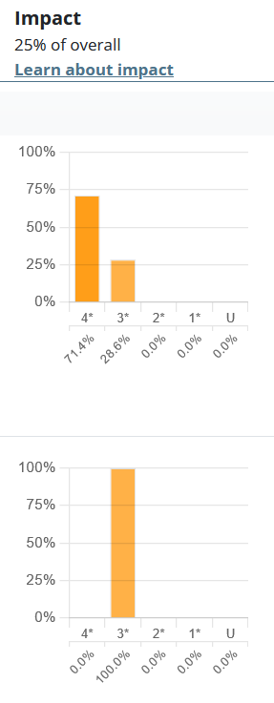
Results –
Impact Cases
https://results2021.ref.ac.uk/profiles/institutions/10007782
Impact rank : =8 of 129

Slide 15
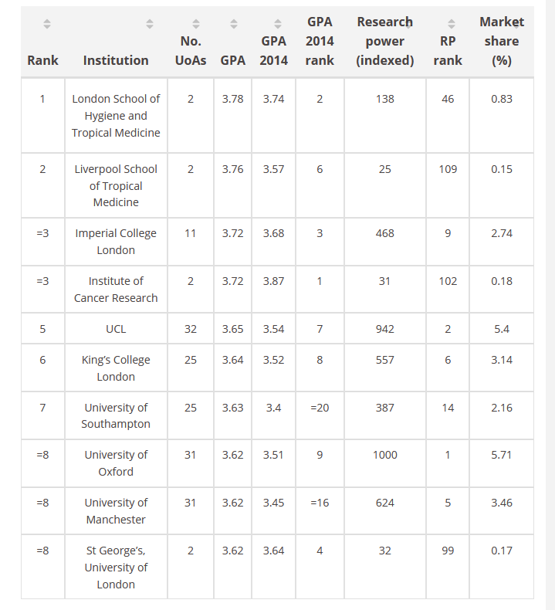

SGUL is strong on Impact
100% of our impact cases were judged 4* (world leading) or internationally excellent (3*), demonstrating our strength in applying our research to benefit society
Impact rank: =8 of 129
https://www.timeshighereducation.com/news/ref-2021-impact-scores
Please include this in grant applications and publicity!

Slide 16

Environment –
Two parts - SGUL overview (not assessed)
- one for each UoA.
Assessment criteria –
Vitality – the extent to which a unit supports a thriving and inclusive research culture for all staff and research students, that is based on a clearly articulated strategy for research and enabling its impact, is engaged with national and international research and user communities and is able to attract excellent postgraduate and postdoctoral researchers
Sustainability - the extent to which the research environment ensures the future health, diversity, wellbeing and wider contribution of the unit and the disciplines, including investment in people and infrastructure
Topics covered:
Unit context, research and impact strategy
2. People
Income, infrastructure and facilities
-
Collaboration and contribution to the research base, economy and society

Slide 17
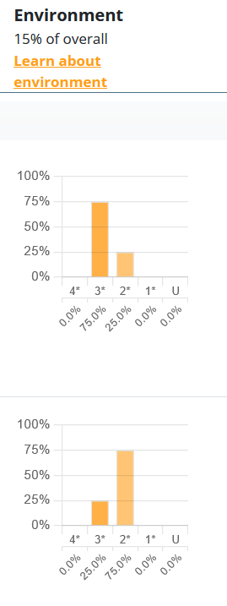
Results –
Environment
https://results2021.ref.ac.uk/profiles/institutions/10007782
Environment rank : =78 of 129

Slide 18
Rankings, Reputation and Income
Income –
In 2017/18, our income from our REF2014 results (mainstream QR funding) was nearly £1.7 million.
Income is determined by total staff (FTE) submitted and by scoring. Currently 4* is worth 4 times the income as 3*, while 2* and below generates no income.
The calculation currently suggests our proportion of the Research England funding pot will increase by about 30%.
We will not know until later in the year.
We expect the calculation may change, and the funding pot size may vary.

Slide 19
Reputation
Results are published in full http://results.ref.ac.uk/.
SGUL’s REF2021 submission overall was sssessed as 36% at 4* quality, which is an improvement on REF2014 where 30% was assessed as 4*.
Analysis of these results is interpreted in multiple ways in a variety of locations
– e.g.
The Times Higher Education (THE) rankings*
The Complete University Guide
The Times/Sunday Times Good University Guide
REF2021 does not rank.

Slide 20
Ranking*
There are many ways to rank, and the most widely quoted rankings are from
The Times Higher Education (THE). They are released on the same day as the
REF2021 results and generate publicity.
SGUL overall ranking https://www.timeshighereducation.com/content/ref2021mainonlinetable
Ranking is based on Grade Point Average (GPA)
= (4 x 4* + 3 x 3* + 2 x 2* + 1 x 1*) / 100
and measures quality and does not take into account FTE (size).
Ranking is out of 129 universities that submitted to >1 UoA.

Slide 21
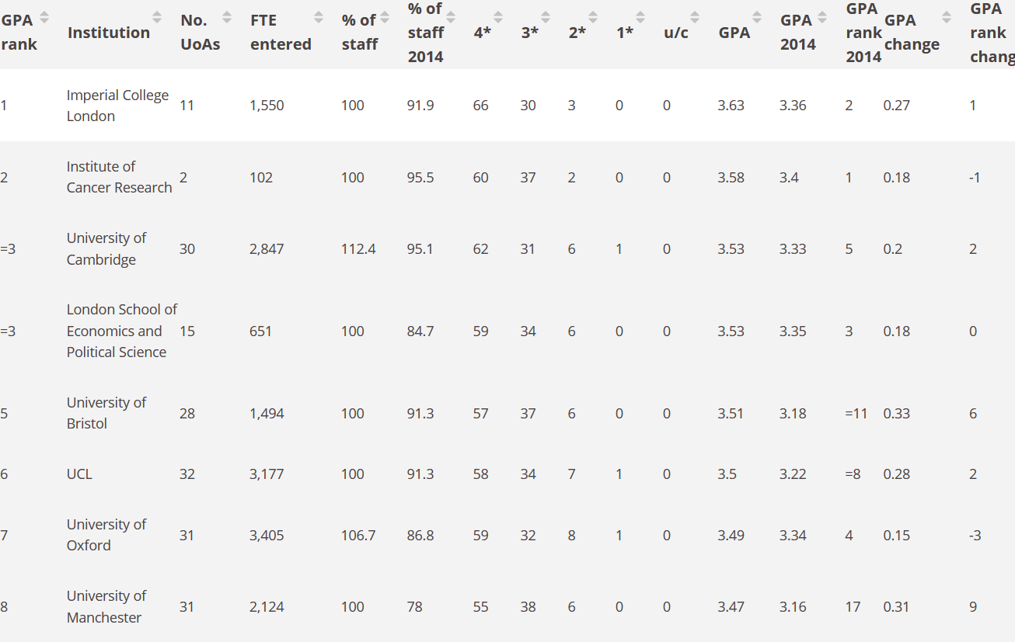
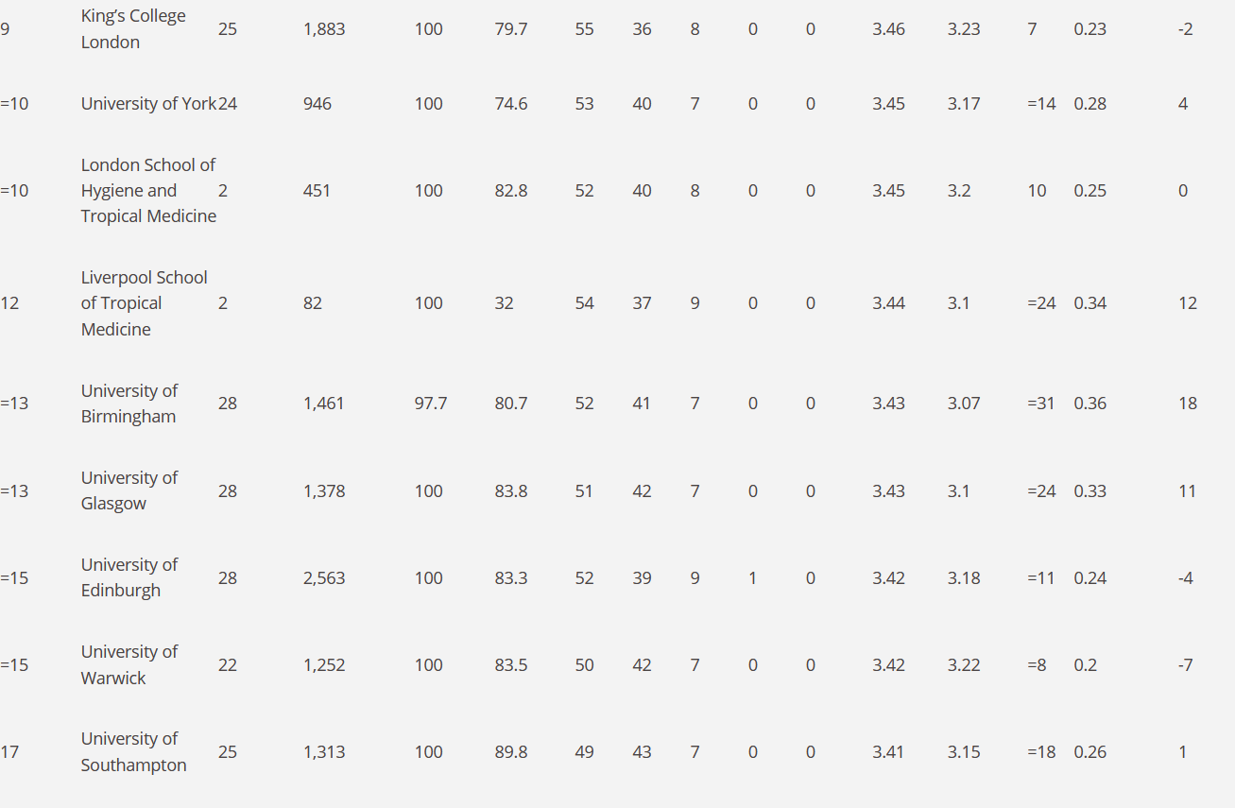
Overall University rankings
Of 129 universities that submitted to >1 UoA
https://www.timeshighereducation.com/content/ref2021mainonlinetable

Slide 22
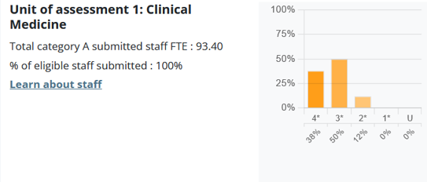
UoA1 Clinical Medicine - SGUL
Overall –
Ranking - =20 of 31 Universities
up from 27 in REF20214

Slide 23
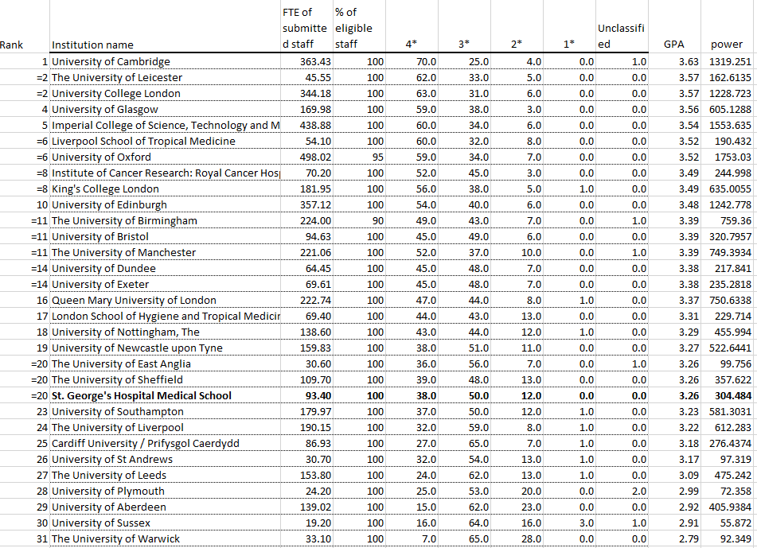

Slide 24
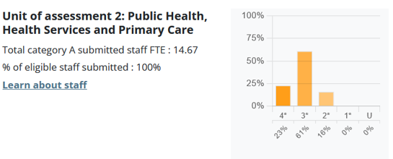
UoA2 Public Health - SGUL
Overall –
Ranking - 27 of 33 Universities

Slide 25
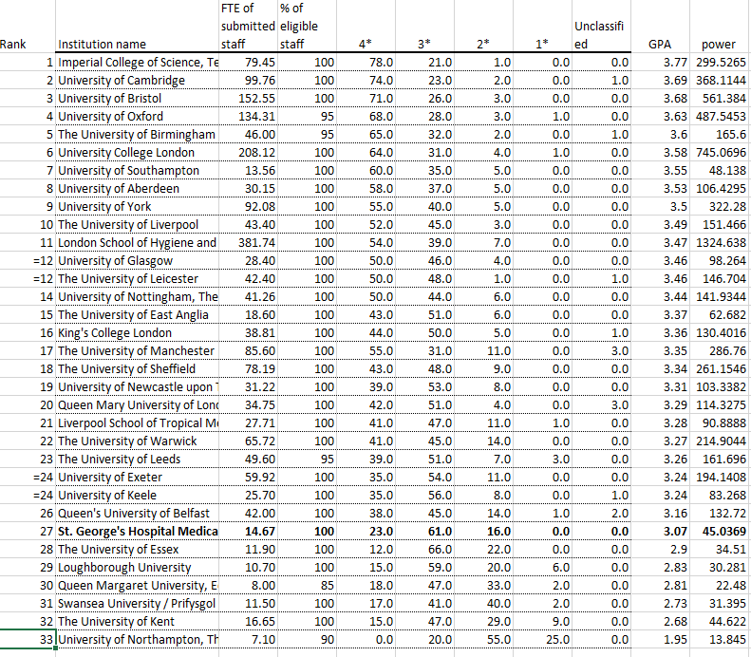

Slide 26
Future REF
There is currently a government consultation on the details of the next REF
(so it will happen!)
Some aspects are likely to be popular, such as returning all eligible staff, outputs, impact cases, open access.
Areas that may change are timing, environment statements.
Please keep up the high quality research!
ensure you papers are open access, and your contribution to papers is stated
Ensure your papers are well cited, use ORCID
Enhance the impact of your research and collect evidence
Take part in initiatives to support the cultural and environmental strengths of SGUL, such as strategy, grants, PhD students, staff development, EDI, supporting ECRs, external advisory committees, etc.

Slide 27
THANK YOU!
SGUL REF Executive committee Impact and Environment
sub-committees
Alicja Rudnicka
Carl Alexander
Craig Wheway
Dorothy Bennett
Jenny Winters
Jon Friedland
Juan Carlos Kaski
Julian Ma
Laura Southgate
Impact Case authors; Internal Output assessors, JRES, Library, HR, Comms.
And thank you to our world-quality Researchers!
Louise Phillips Ambalika Batra
Mark Cranmer David Strachan
Peter Garrard John-Edward Butler-Peter Whincup Ransohoff
Rachel Allen Mark Fisher
Sue David Mary Chambers
Tom Harrison
Vanessa Ho
Yvonne Castle
Questions?
Jodi Lindsay – jlindsay@sgul.ac.uk
Academic Lead for REF

